Slide 1
Blind estimation of acoustic transfer functions (ATFs) and dereverberation based on convolutive transfer functions (CTFs) Date：2024. 06. 12
Telecom Electroacoustics Audio(TEA) Lab
Presenter:
Anchi Yuan
Notes:
Hello everyone
I’m today’s presenter siang. I’m going to share some of my present work in source separation problem. My topic is comparative studies of source separation using semi-blind and blind source separation approaches.

Slide 2
Outline
Last experiment result
Problem
New Experiment setting picture
New Experiment setting
New Experiment result

Slide 3
Last experiment result

Slide 4
Problem
electric signal
diaphragm signal
mic signal
speaker
room
estimated ATF
tfestimate groud-truth ATF

Slide 5
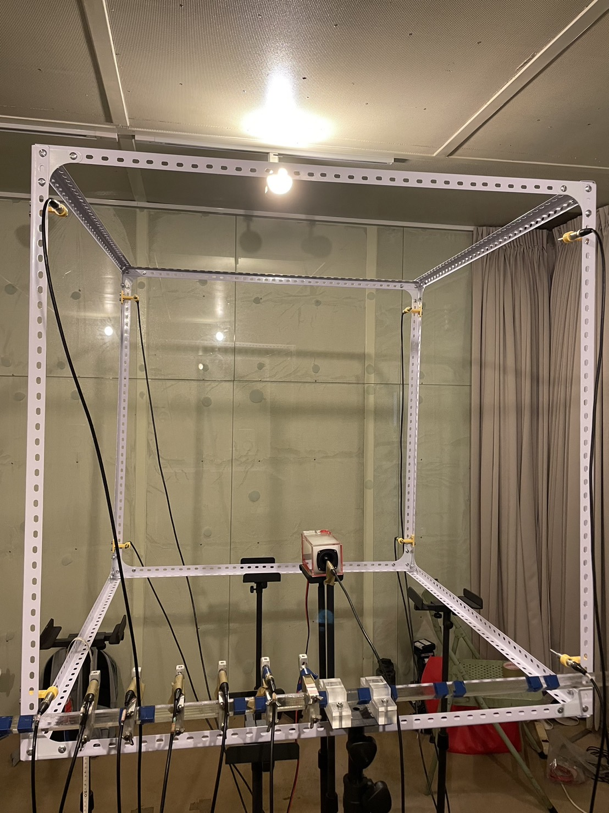
New experiment setting picture

Slide 6
New experiment setting
Experiment place : listening room
Measured reverberation time T₆₀ = 0.12s
Array type : distributed array + sparce array
Number of microphones = 8+5=13
Sampling frequency = 48kHz
Source type : white noise

Slide 7
New experiment result
200
1000
10000
1000
10000
200
Only ULA
Only distributed array

Slide 8
New experiment result
200
1000
10000
hybrid array

Slide 9
